Slide 1
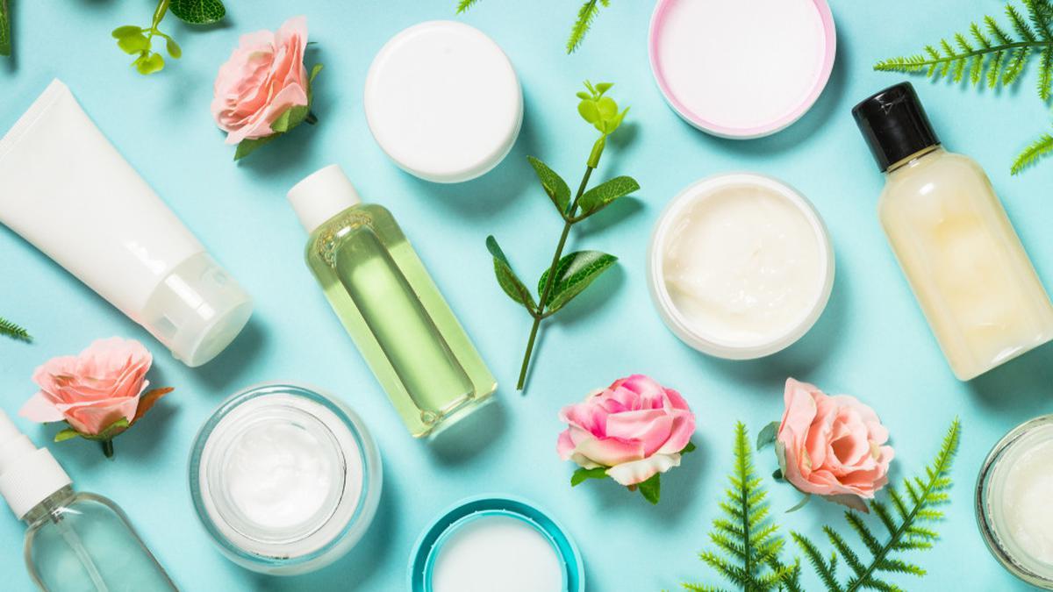
Skincare Market Trends Across Economies
Presented by Anoushka Hazari

Slide 2
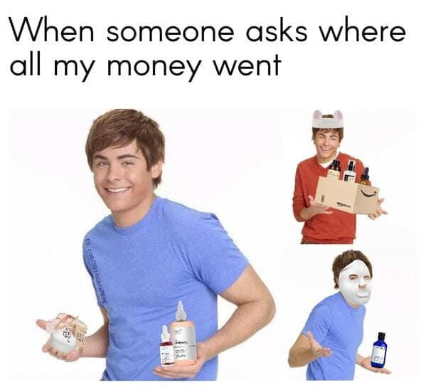
Agenda
Overview of Beauty Consumption Trends Globally
Market sizes and growth patterns across key countries.
Income Impact on Beauty Spending
Correlation between GDP per capita and beauty product consumption.
Comparative Benchmark: India vs. Major Markets
India’s current position relative to China, Korea, US, and Japan.
Growth Opportunities and Market Inflection Points
Identifying India’s potential consumption breakout phase.
Strategic Insights and Investment Implications
What the data means for future growth, category innovation, and market entry.

Slide 3
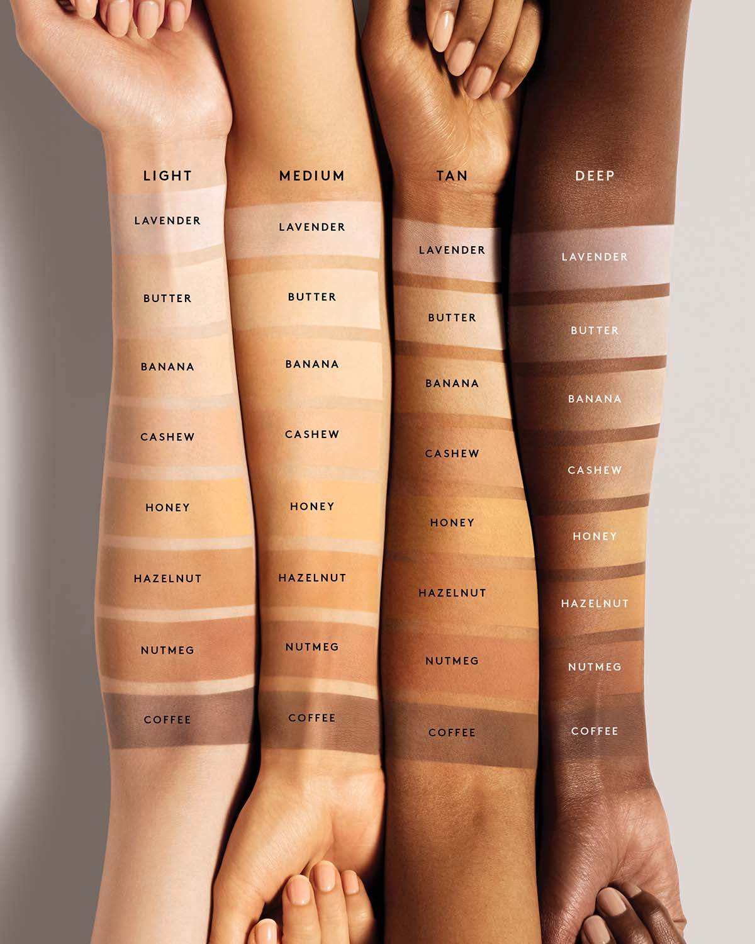
Introduction
The beauty and personal care (BPC) industry has experienced rapid global expansion over the past decade, driven by rising disposable incomes, demographic shifts, and evolving consumer preferences. Understanding how economic indicators—particularly GDP per capita correlate with BPC spending can offer valuable insights for multinational firms, policymakers, and investors. This paper presents a multi‐method analysis combining descriptive statistics, time‐series forecasting, clustering, and growth‐stage classification to compare BPC spending dynamics in five representative economies.
ThePhoto by PhotoAuthor is licensed under CCYYSA.

Slide 4
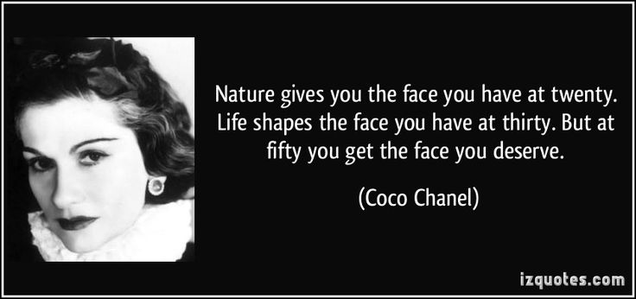

Slide 5
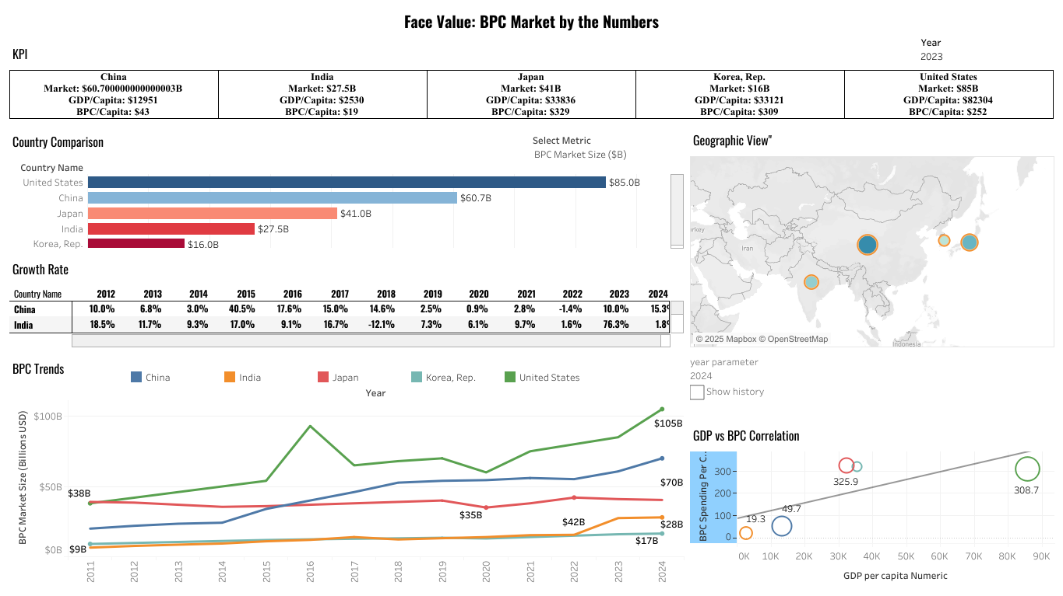
Does Beauty Consumption Scale with Income? Cross-Market Evidence
DB1 Link : https://public.tableau.com/app/profile/nush.h/viz/SkincareIndustryAnalysis/Dashboard1

Slide 6
Global BPC Spending
KPIs show GDP per capita, BPC market size, and BPC per capita by country (2011–2024).
Chose 2011 as the start year since India’s BPC industry began expanding then.
GDP per capita rose post-2014, aligning with a sharp BPC boom in 2015–2016.
Country comparison via bar chart + geo view highlights India’s position globally.
Growth rate table shows a –12% dip in 2018 (due to GST, demonetization) and +76% spike in 2023 (due to local brands & social media).
India’s BPC market = $28B in 2024, but only ~$19 per person vs Korea’s $318—shows huge untapped potential.
Bubble chart compares GDP vs BPC spending per capita—India underperforms, signaling growth opportunity.
Overall, visuals reveal spending gaps, emerging trends, and future market potential for India’s BPC industry.

Slide 7
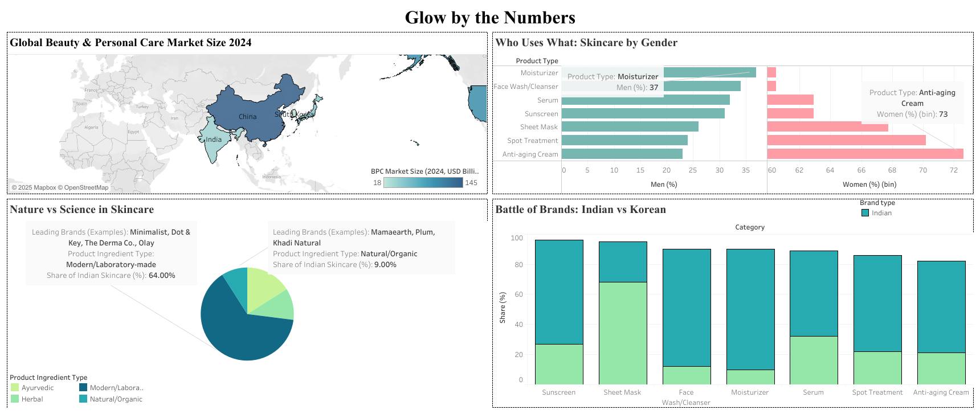
Does Beauty Consumption Scale with Income? Cross-Market Evidence
DB2 Link : https://public.tableau.com/app/profile/nush.h/viz/SkincareIndustry/Dashboard1#2

Slide 8
Asia’s Beauty Market Shift
China dominate Asia’s BPC market — with India as a fast-emerging growth engine
Women lead skincare usage, but men show rising interest — opening new product segments
Despite cultural roots, lab-made skincare leads in India (~66%) — but demand for natural/organic is growing
Korean brands drive innovation in advanced skincare; Indian brands hold ground in basics
Major whitespace for India in:
Premiumization
Male grooming products
Hybrid science + heritage skincare
📈 India is at a turning point — with rising income, evolving preferences & global influence converging. Now is the moment to innovate and scale.

Slide 9
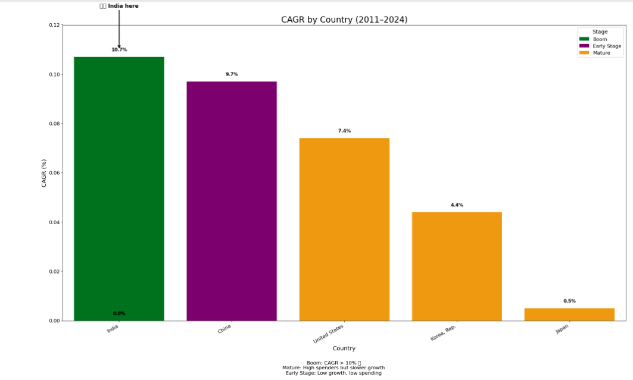
BPC Market Compound Annual Growth Rate (2011–2024) by Country

Slide 10
Summary Table
Country | CAGR | Stage | Why?
India | 10.7% | Boom | New buyers, rising income, digital expansion, social trends
China | 9.7$ | Early | Strong growth but nearing saturation
Japan | 0.5% | Mature | Flat growth, aging population, already saturated
Korea | 4.4% | Mature | Innovation leader, but market is saturated
United stated | 7.4% | Mature | Big stable market, slower growth

Slide 11
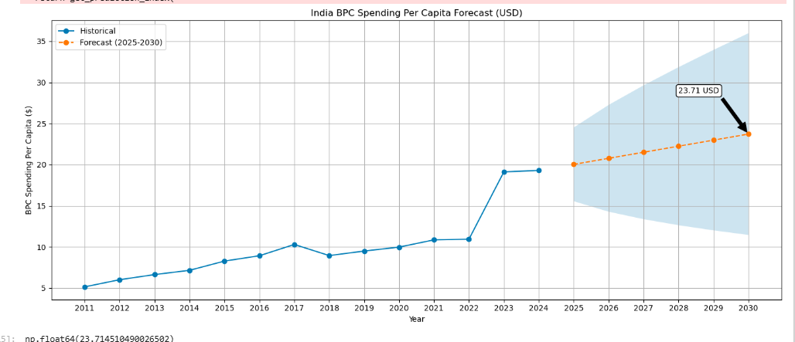
Is India’s BPC Market Really “Booming” by 2030?
Per capita BPC spend to rise from $19 (2024) to ~$23–$24 by 2030 – a modest $4–$5 increase
Growth is steady but not explosive, signaling early-stage market development
Still far behind mature markets like Korea, Japan, and the U.S. ($300+)
India is entering the inflection zone where acceleration typically begins (based on China/Korea trends)
Strategic opportunity: Now is the time to invest, build brand presence, and ride the next growth wave

Slide 12
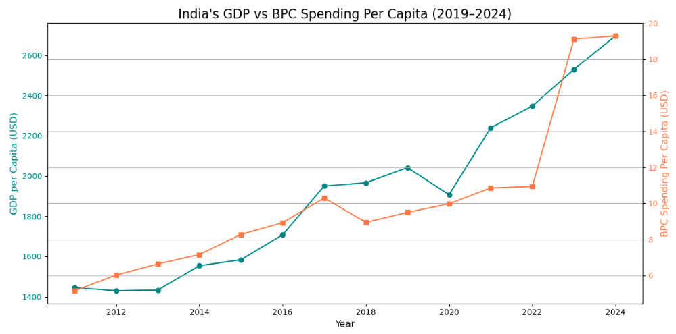

Slide 13
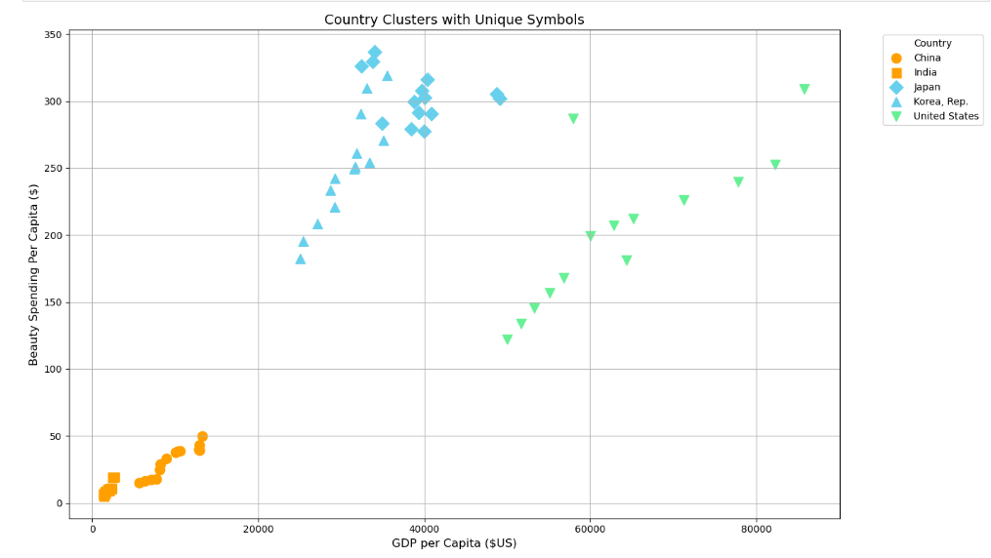
KNN Classification

Slide 14
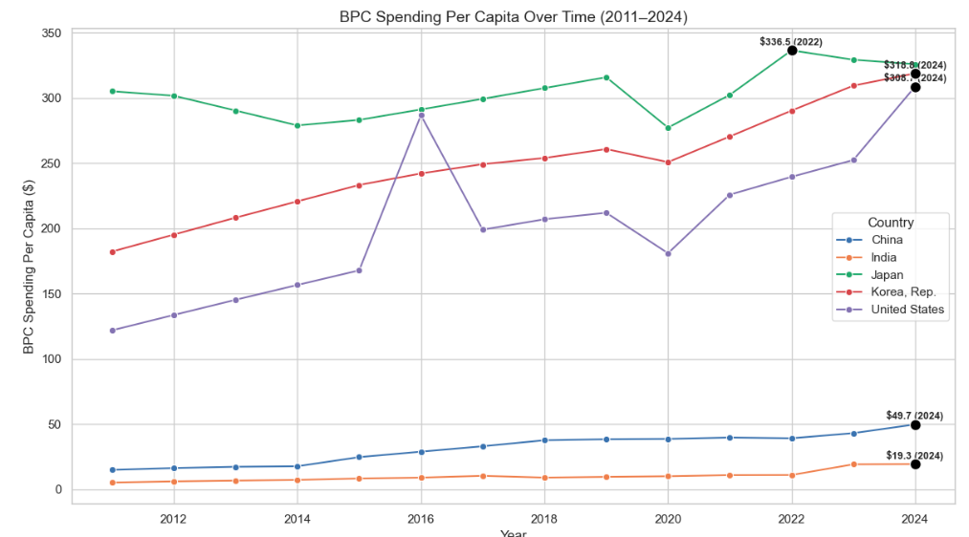
Time Series

Slide 15
Conclusion
India’s BPC market is on the cusp of a significant expansion but has not yet hit the true “booming” stage seen in more mature Asian markets. Rising incomes, urbanization, and digital transformation are steadily lifting consumer spending from very low per capita levels. The coming decade offers a strategic growth window for brands and investors to build market share and loyalty before the Indian beauty sector enters its rapid acceleration phase.
The market’s size today is driven by population, not high per capita spend, leaving huge opportunity for category adoption, premium product innovation, and male grooming expansion. The data-driven KNN insights back this story—India’s current position is a strong signal that it will likely follow the success paths of China and Korea if the right investments and brand strategies are made now.

Slide 16
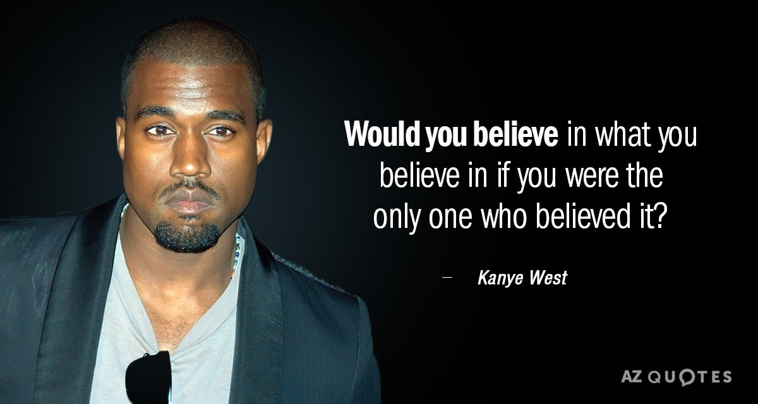
Future Growth and Analysis
India’s BPC spend to rise from ~$19 (2024) to ~$23–24 (2030).
Large growth potential; still far below mature markets’ per capita spend.
Drivers: rising incomes, urbanization, digital sales, male grooming.
Innovation and premium products key for expansion.
Market approaching early acceleration; boom phase likely beyond 2030.
Segment by demographics (age, gender, urban/rural).
Impact of pricing and taxes on demand.
Online vs offline sales trends.
Brand competition and loyalty dynamics.
Consumer trends: natural vs synthetic, clean beauty.
Scenario forecasting with macroeconomic variables.
Cross-country market comparisons for validation.

Slide 17
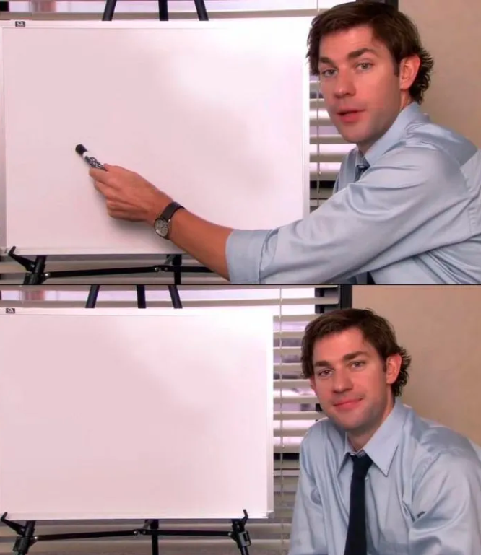
What do I bring to the table!
I start with a spreadsheet and end with world domination — that’s what she said.

Slide 18


